Slide 1
Cosmology Lite
A brief treatment of some basic topics in cosmology
1) Overall framework: expansion and three differential relations
2) The Friedman equation and its solutions
3) The angular relations: curved space
4) Space time diagrams
5) Real time cosmology

Slide 2
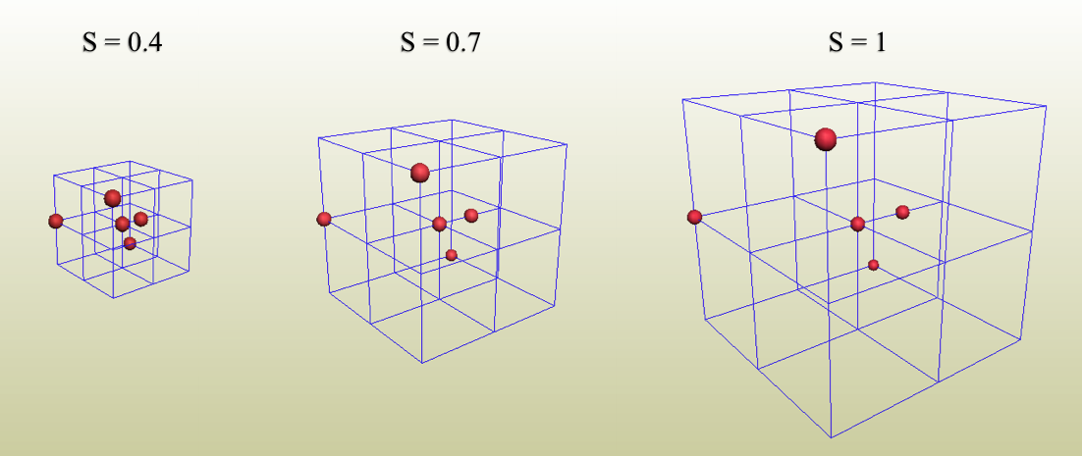
Cosmic Expansion & the Scale Factor
S = 0
BB
0
Time
Today
Space (shown by the grid) expands and galaxies are “fixed” on it.
Note: The galaxies themselves do not expand!
Grid size specified by scale factor: S S=1 today, S=0 at BB (often “a” in literature)
Pick galaxy for us. Today: others galaxies at comoving distances: r₀ (“0” = today)
Other times: r = S r₀ or S = r/r₀ (same for all galaxies)

Slide 3
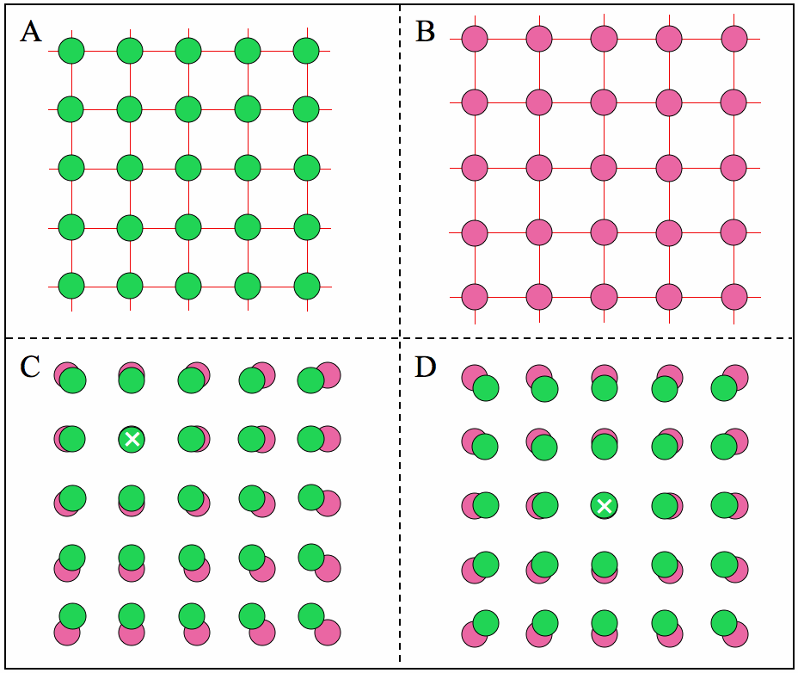



The velocity-distance law
Expanding grid: galaxy distances increase.
Cast as velocity. Take the time derivative:
Thus, we have a linear velocity-distance law
Introduces the Hubble parameter/constant: H, H₀ Units of 1/time, defining Hubble time and distance:
Today’s values:
H₀ ≈ 22 km/s/Mly
(0.0735 Gyr⁻¹)
t_{H0} ≈ 13.6 Gyr
r_{H0} ≈ 13.6 Gly
Note 1: Rigorously true to all distances (follows from uniform expansion)
e.g. At r = r_{H} , v = c; at r = 100 r_{H} , v = 100c. (This is OK in GR)
Note 2: Same law for all observers (galaxies) – see figure.

Slide 4
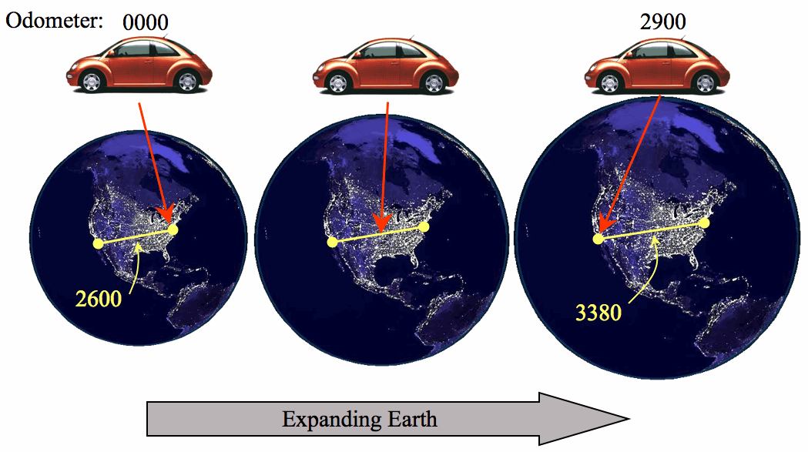
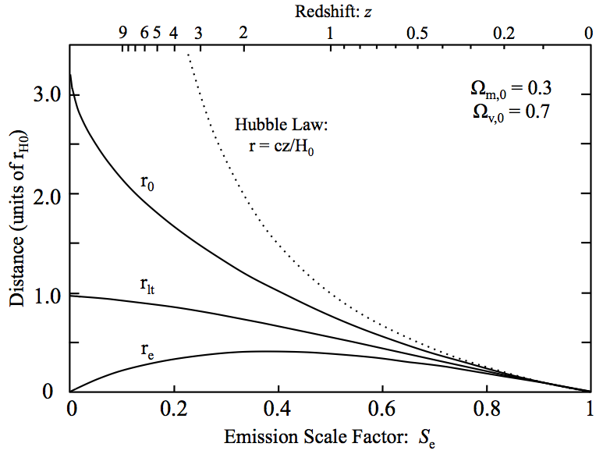
Light’s motion across expanding space
When light moves from a distant galaxy to us, there are THREE distances to consider:
r_{lt}
If Earth static, then all three distances are the same. But if Earth expands, they’re all different.
Analog: car moves at 60 mph (c) across expanding Earth
r_{e}
r₀
r_{e} emission distance = the distance when
light set out.
r₀ today’s distance = distance when light
arrives, today. (= comoving distance)
r_{lt} light travel distance (odometer reading).
= journey’s duration = look-back time

Slide 5
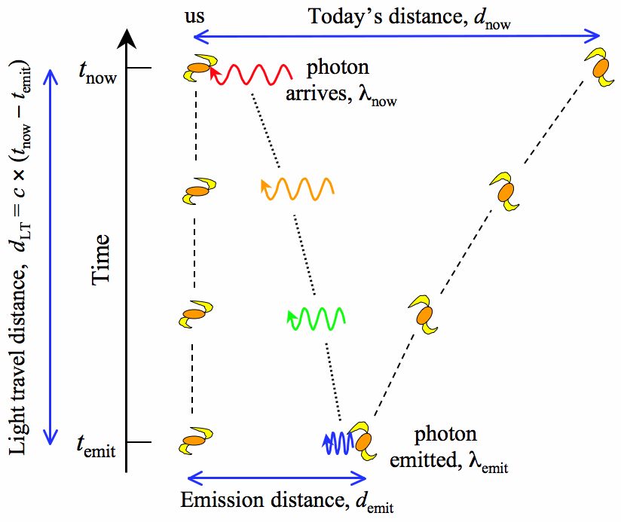
Redshift: S_{e} and z
Space-time diagram (see later)
Light waves and the Universe are stretched by the same factor
r₀
t₀
λ₀
Reshift tells us the scale factor when the light set out!
Conventionally, use z:
r_{lt}
t_{e}
Clearly:
λ_{e}
r_{e}
and
Note: Cosmological redshift is different from Doppler or gravitational redshifts.
Redshift is our primary observable!!

Slide 6
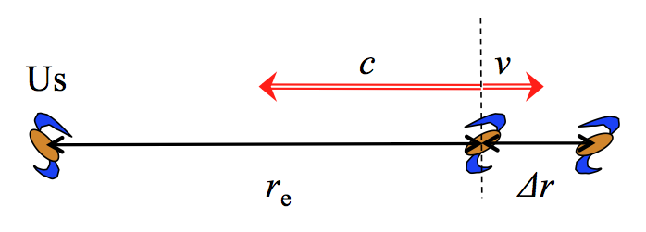
The Hubble Law
More distant objects have longer light travel times, so expansion is greater.
➔ Expect larger redshift for more distant objects. Hubble finds this in 1926:
This is a low redshift observational approximation to the velocity-distance law.
Question: is cz = v₀ and is D = r₀ ? The answer is “only approximately”.
and
This is an an approximate Doppler expression
Also: v ≈ ½ (v_{e} + v₀), not v₀; light travels r_{lt} not r_{e}; and Doppler cz isn’t v_{e} or v₀.
The velocity-distance law: v₀ = H₀ r₀ is exact but unobservable.
The Hubble law: cz ≈ H₀ D is an observational approximation to it.

Slide 7
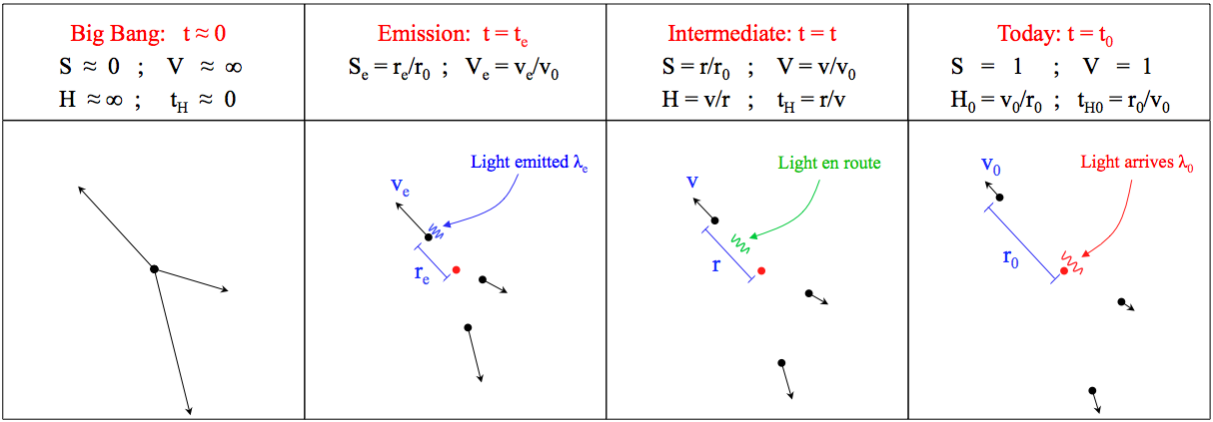
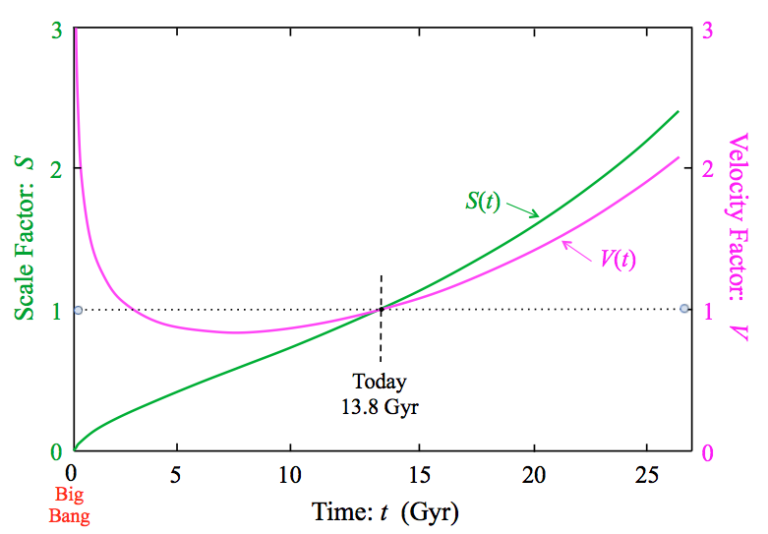


Changing velocities; the velocity factor: V
How does a given galaxy’s recession velocity change over time?
(Note: velocity-distance law is for a fixed time; different galaxies have v r)
Analogous to scale factor is
velocity factor, V:
Divide v = dr/dt
by v₀ = H₀ r₀
S(t) and V(t)
Normalized version
of v = dr/dt
S and V are dimensionless

Slide 8
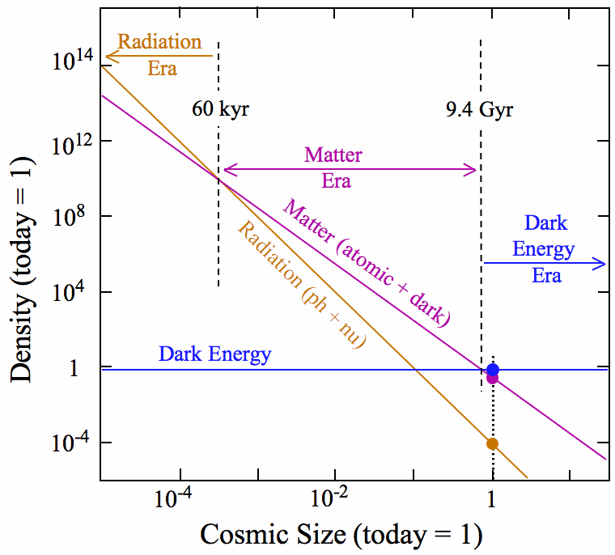
Three Cosmic Constituents
For our purposes, there are three kinds of cosmic constituent.
Matter: non-relativistic; energy in rest mass → no change with expansion.
Radiation (γ + ν): relativistic; energy in motion → redshift during expansion.
Vacuum: ρ_{v} same for all observers; SR → ρ_{v} remains constant during expansion.
Their density changes with expansion:
Matter: ρ_{m} = ρ_{m,0} / S ³ simple dilution
Radiation: ρ_{r} = ρ_{r,0} / S ⁴ dilution + redshift
Vacuum: ρ_{v} = ρ_{v,0} constant
Three Cosmic Eras
Two transitions of density equality:
1) Matter-Radiation: ρ_{m} = ρ_{r}
2) Matter-Vacuum: ρ_{m} = ρ_{v}
Scale Factor: S

Slide 9

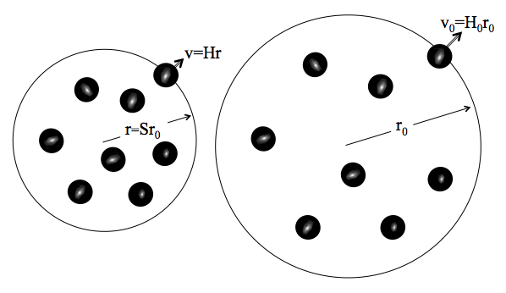





An Expanding Sphere of Matter
A Newtonian analysis of an expanding sphere contains
the relevant physics.
Start with just matter, expanding with v = H × r
Consider the KE & GE of a galaxy mass, m, on the edge:
Define the ratio of GE to KE, and call it Ω:
(this is independent of r so holds for all gals)
Consider special case: Ω = 1 so TE = 0
Ω can also be written:

Slide 10




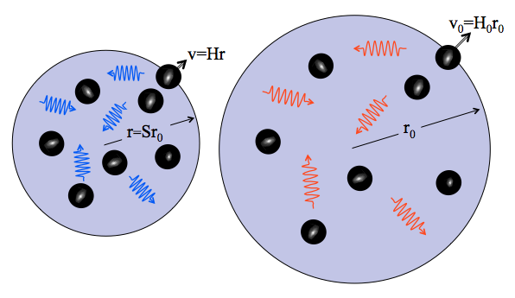



The Friedman Equation: V(S)
How does the velocity factor, V, change as the Universe expands, i.e. what is V(S)?
A Newtonian analysis gets us the answer.
Consider a galaxy: its energy is conserved during the expansion:
Normalize (make dimensionless): divide by KE₀
Matter only
KE + GE = TE
Adding the other components is straightforward:
KE + GE = TE
where
and
Note: reality has Ω_{t,0} = 1 so RHS = 0.

Slide 11

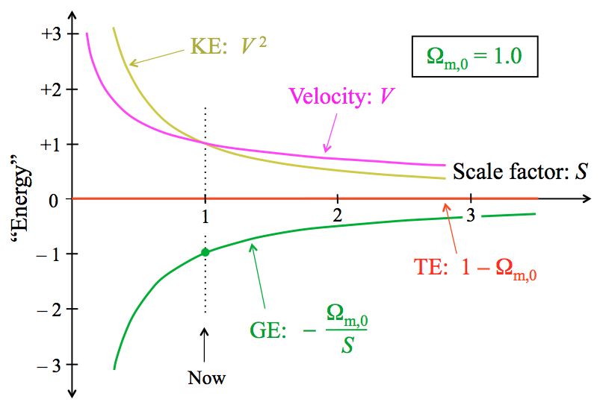
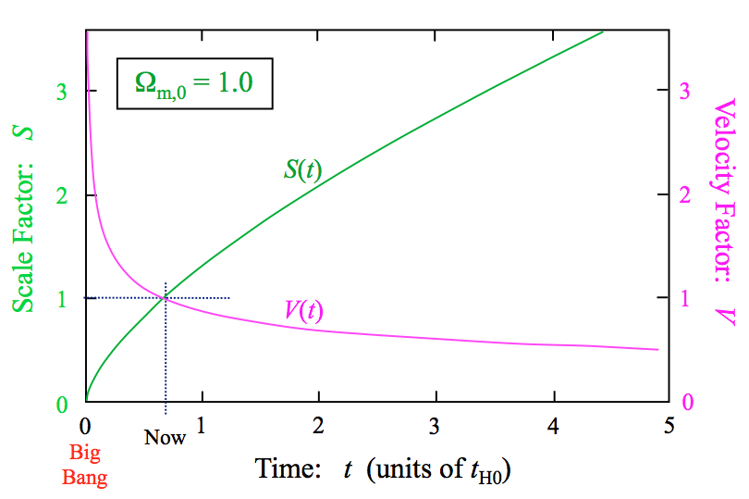
Friedman Solutions: Pure Matter
Choice of Ω’s define the expansion solution.
First review matter-only, then do other components.
Energy diagram: Shows Friedman terms Gives V ²(S) and hence V(S).
How to go to S(t) and V(t)?
We have:
Integration gives:
Relative Energy
This gives t(S). Invert to get S(t).
Get current age from:

Slide 12
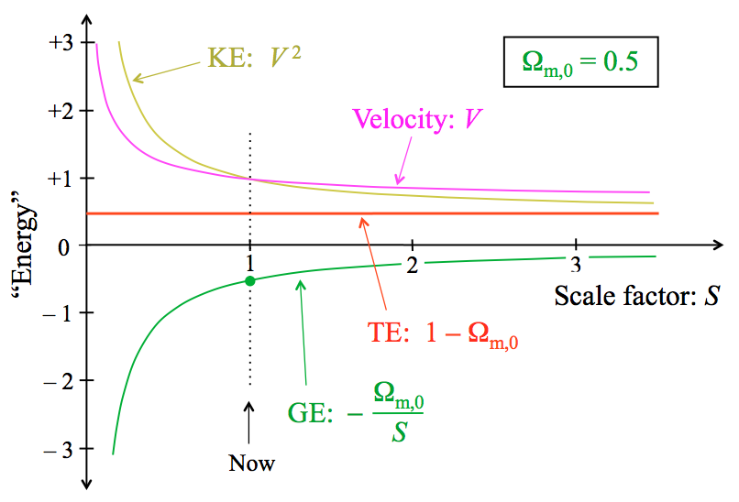
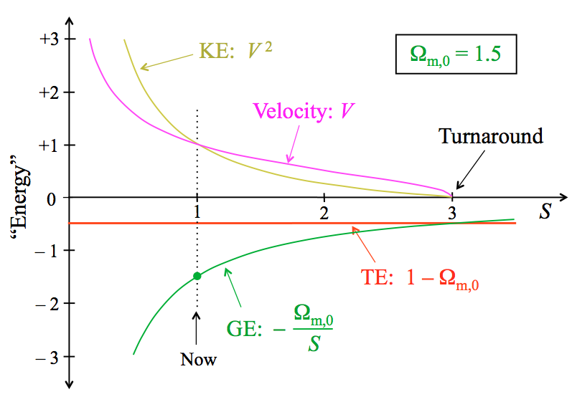
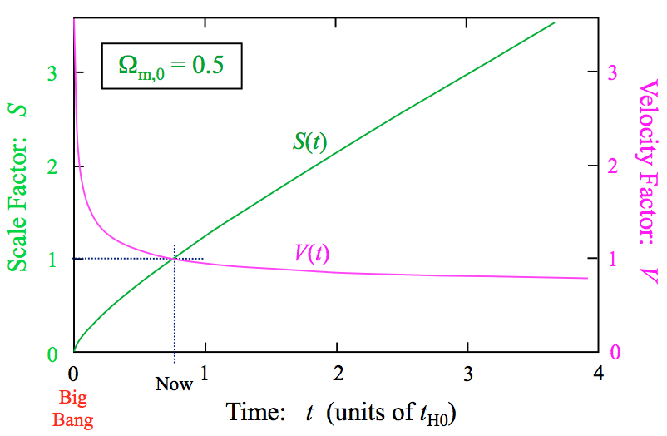
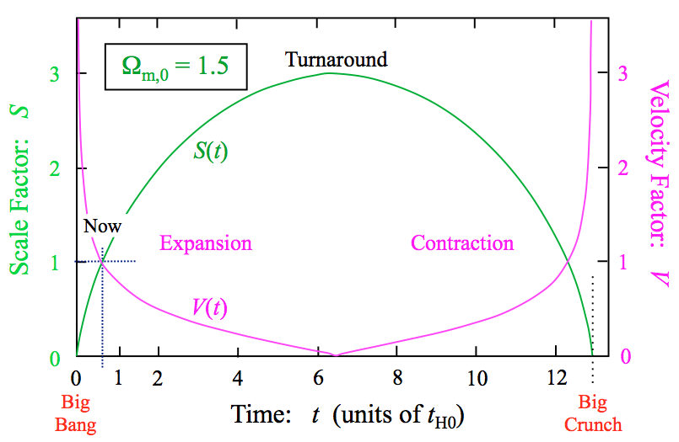
Friedman Solutions: Pure Matter
Lower matter density
Higher matter density
Relative Energy
Relative Energy
V = const

Slide 13
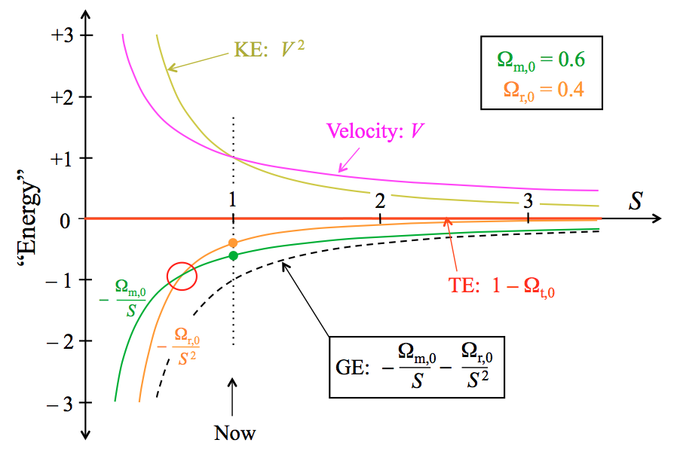
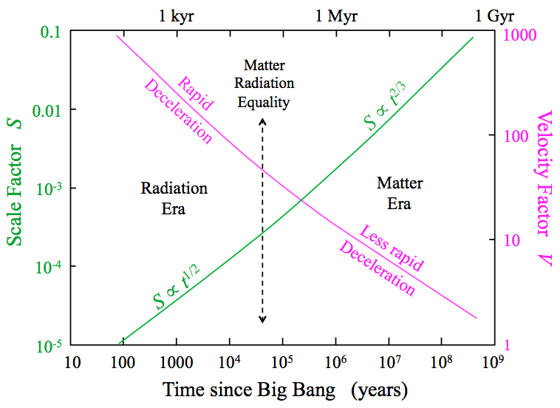
Matter plus Radiation: Early Times
Radiation dominates at early times.
Equality occurs when ρ_{r} = ρ_{m}
Equality
Relative Energy
Real Universe: Ω_{m,0} = 0.3 Ω_{r,0} = 8.4E-5
S_{eq} = Ω_{r,0}/Ω_{m,0} = 2.8E-4 or t_{eq} = 50 kyr
Transistion is very important.
Radiation era: S ~ t^{1/2} V ~ t^{-1/2}
Matter era: S ~ t^{2/3} V ~ t^{-1/3}
Slope of GE&KE curves → deceleration
d(V²)/dS = 2V dV/dt × dt/dS
= 2V dV/dt × t_{H0} /V
= 2t_{H0} dV/dt = 2A (acceleration)
Or:
a = -grad Φ = -d(GE)/dS

Slide 14
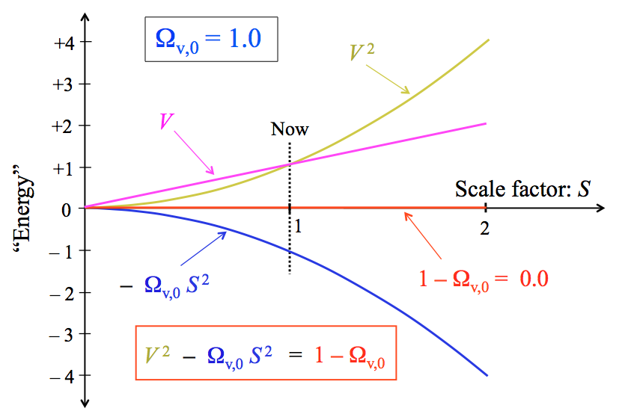
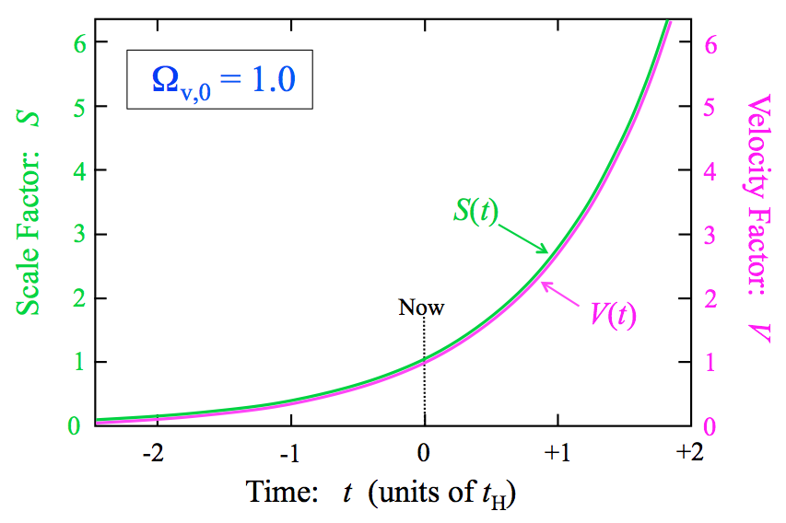

Vacuum
Because vacuum GE gets more negative with S, KE increases with S giving acceleration.
For Ω_{v,0} = 1, we have V = S.
This gives exponential growth with e-folding time t_{H0}:
Relative Energy
Note: this is the nature of Inflation, where the vacuum density is very high so t_{H0} is very short.

Slide 15
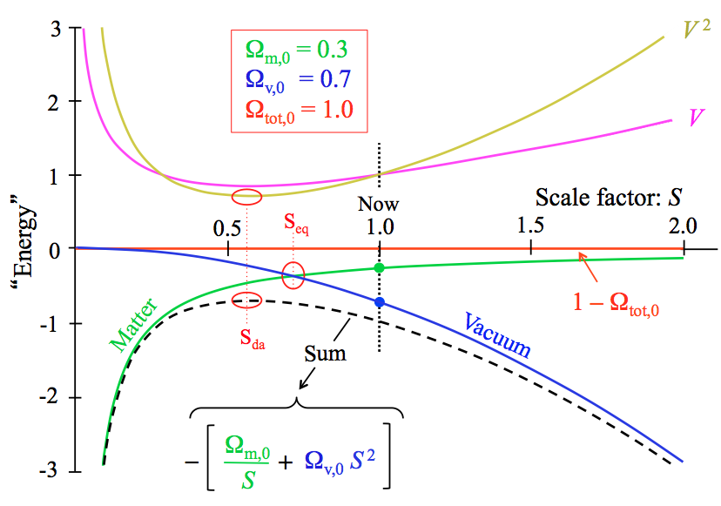
Matter plus Vacuum: Late Times
Sum of matter and vacuum gives a “hilltop” GE shape:
Early deceleration (matter domiantes)
Late acceleration (vacuum dominates)
Relative Energy
Equality occurs when ρ_{m} = ρ_{v}
For Ω_{m,0} = 0.3 and Ω_{v,0} = 0.7, S_{eq} ≈ 0.6
Coasting when slopes of GE curves for matter and vacuum equal and opposite.
For Ω_{m,0} = 0.3 and Ω_{v,0} = 0.7, S_{da} ≈ 0.75
Cosmic Age: t₀ = 0.96 t_{H0}

Slide 16
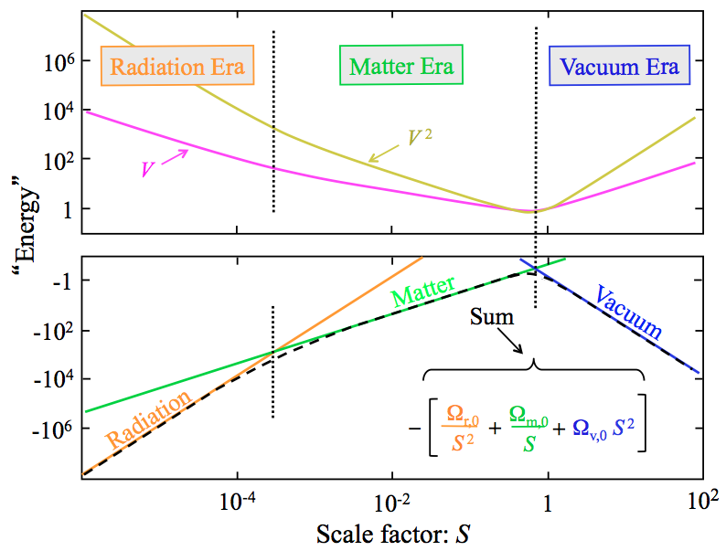



The Real Universe: All Three
Energy diagram with log axes
Relative Energy
The Friedman equation gives the form for V(S) or V(z):
Note: often H is used as main variable:

Slide 17
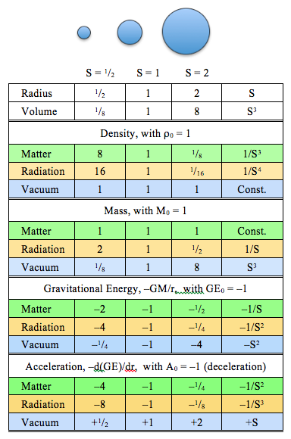
Intuiting vacuum’s accelerating expansion
Given that vacuum’s density is constant, then the mass of an expanding sphere increases.
In this case the GE for unit mass at the surface decreases (more negative) as sphere expands.
Thus: outwards is “downhill”.
Vacuum sphere’s fall outwards, naturally!
Where does the new mass come from??
Several possible answers:
Newtonian: new mass created from negative global gravitational energy (-GM²/R).
E.g. a sphere with R ~ r_{H0} has GM²/R ~ Mc².
Einstein: G_{i,j} = 8πG/c⁴ × T_{i,j} so gain on RHS has matching gain on LHS – i.e. the new energy comes from the changing metric.

Slide 18
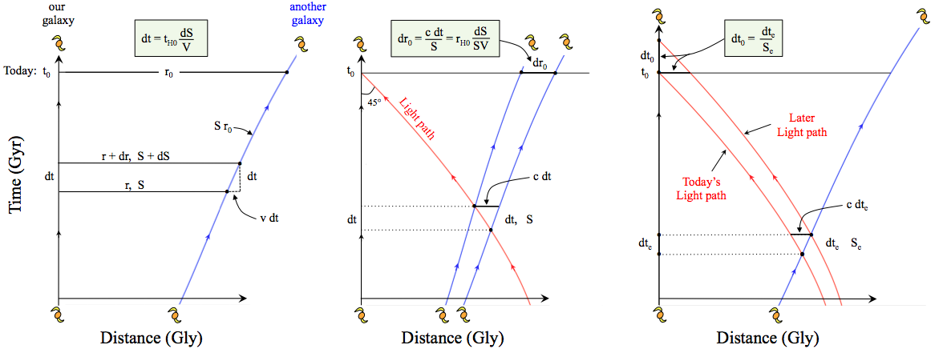




Three important differentials
Simple space-time diagrams yield three useful differential relations.
Blue lines are paths of receding galaxies (world lines).
Red line is “past light cone”. All today’s visible galaxies lie on this line.
Cosmological time dilation: distant events appear slowed down.
Distance between two close objects on our light path.
Simple kinematics

Slide 19




Three important differentials (cont.)
If you prefer to work with redshift, z, the differential relations become:
Direct application of the differential relations:
Time interval corresponding to given redshift interval, dz:
dt = t_{H0} S ²/V dz. Clearly, this gets very short at high-z (small S):
e.g. at z ≈ 20, S ≈ 1/21, V ≈ 2.4, S ²/V ~ 10⁻⁵ so dz = 1 gives dt ≈ 1.3 Myr
Comoving separation corresponding to given redshift interval dz:
dr₀ = r_{H0}dS/SV = –r_{H0} S/V dz.
e.g. At z ≈ 20, S ≈ 1/21, V ≈ 2.4, S/V ≈ 0.02, so dr₀ ≈ 0.02 r_{H0} ≈ 0.26 Gly.
Redshift is simply Cosmological time dilation: dt₀ = dt_{e}/S_{e}
For light wave periods: 1/f₀ = 1/f_{e} / S_{e} or S_{e} = f₀/f_{e} = λ_{e}/λ₀

Slide 20
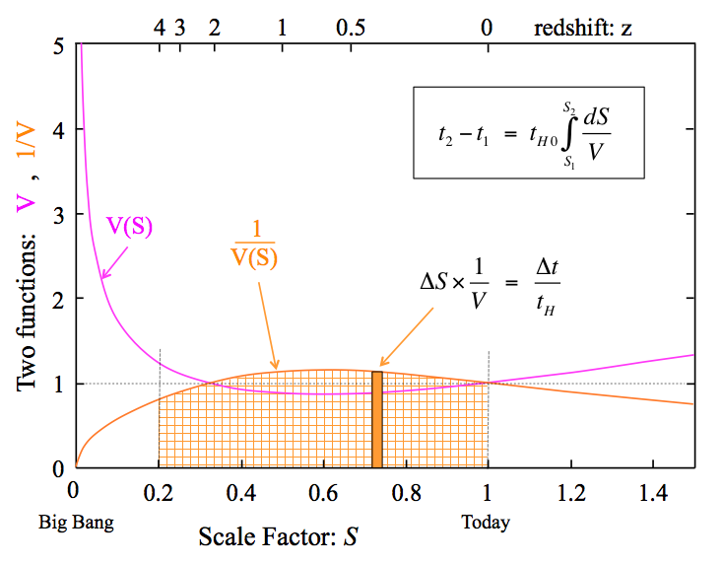




Calculating times
Use first differential to calculate time intervals:
Basically, duration of journey with speed v(x) from x₁ to x₂: use v = dx/dt, so dt = dx/v so integrate dx/v from x₁ to x₂ to find duration.
a) Lookback time:
b) Age at S_{e}:
Invert to get S(t)
c) Today’s age:
Example: z = 4 galaxy (S_{e} = 0.2). V = [0.3/S + 0.7 S ²]^{1/2}. See figure.
Lookback time: integrate from S_{e} = 0.2 to 1.0 gives t_{lt} ≈ 0.85 t_{H0} ≈ 11.5 Gyr.
Age at z = 4: Integrate from 0 to 0.2, gives t(0.2) ≈ 0.11 t_{H0} ≈ 1.5 Gyr.

Slide 21
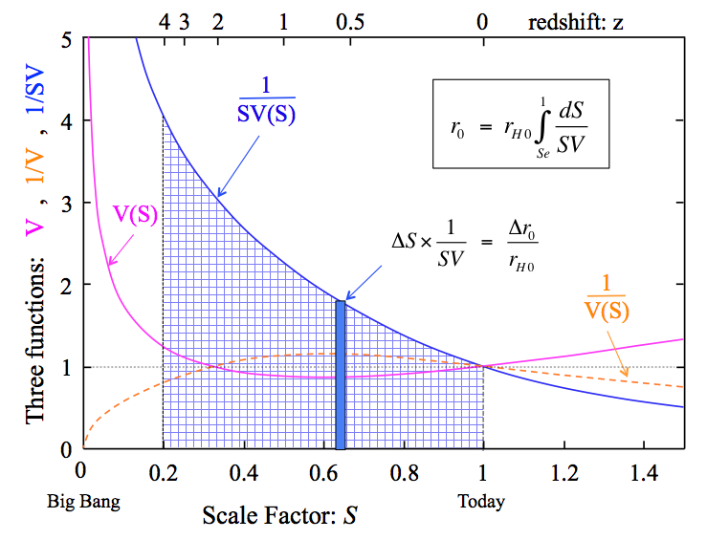




Calculating Distances: r₀ and r_{e}
Integrate dr₀ differential to calculate distances:
a) Comoving distance, r₀:
Previous example (z = 4; S_{e} = 0.2):
Integration gives r₀ = 1.67 r_{H0} ≈ 22.7 Gly
b) Emission distance, r_{e}:
r_{e} = 0.33 r_{H0} ≈ 4.5 Gly
c) Light travel distance: r_{lt} = ct_{lt}
Same as lookback time: 11.5 Gly. Notice r_{e} < r_{lt} < r₀.
d) Particle horizon, r_{ph,0}, = furthest we can see:
Integration gives: r_{ph,0} ≈ 3.3 r_{H0} ≈ 46 Gly.
e) Event horizon, r_{eh,0}, = furthest we can signal:
Also, distance beyond which we will never see an
event that happens today.
Integration gives: r_{eh,0} ≈ 1.14 r_{H0} ≈ 15.4 Gly.

Slide 22
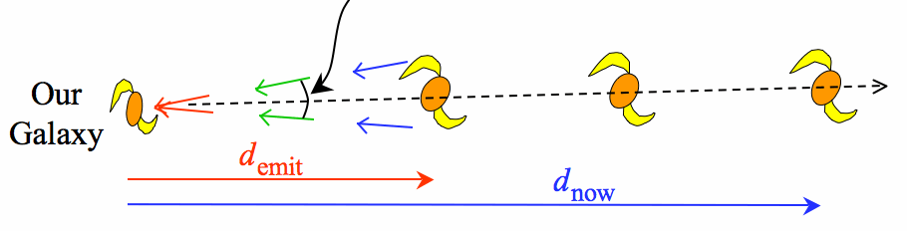
Calculating Sizes from Angles
What’s the size, Δ, of an object at distance r that subtends a small angle θ radians?
θ
2π
For a static, Euclidean space: Δ = C × = r × θ
where C is the circumference of a circle of radius r.
In cosmology, we have two complications:
Which r do we use? Answer: we use r_{e} = S_{e} r₀ (see figure)
Space may not be Euclidean
θ
r_{e}
r₀
For non-Euclidean space, a circle’s circumference-radius relation is modified:
C = 2πr × F_{c} where F_{c} is a correction factor.
Hence our true relation is:
Where D_{A} = S_{e} r₀ F_{c} is an angular diameter distance: a pseudo-distance that gets Δ correct using the static Euclidean relation.
What is F_{c} ? …..

Slide 23
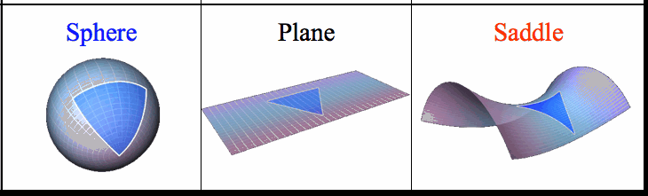
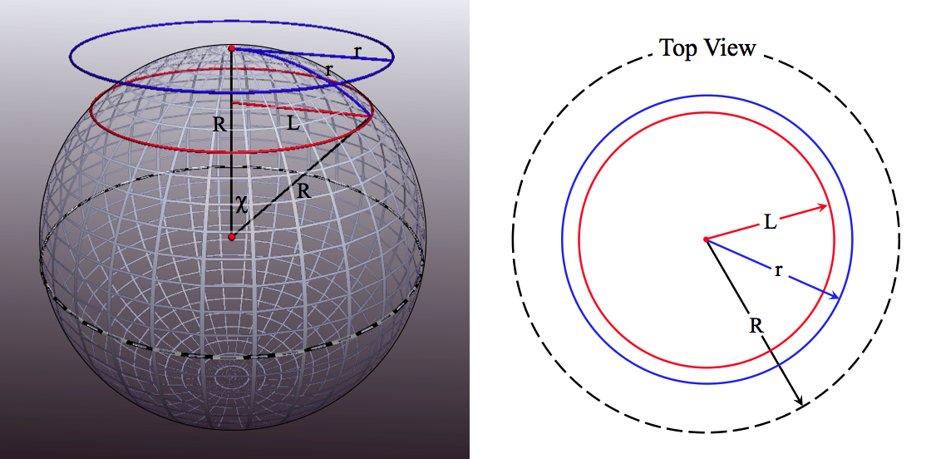
Curved Geometry
Einstein’s GR: space-time geometry linked to mass/energy and momentum:
Fortunately in cosmology, isotropy & homogeneity → geometry is simple.
Time separates out; space has single curvature parameter, R (positive or negative).
Rules of geometry are different from Euclidean:
Equivalent to geometry on a curved surface.
Circle circumference C = 2πr F_{c}
Sphere area: A = C ²/π = 4πr² F_{c}²
Sphere volume: Vol = ⁴/₃ πr³ F_{cv}
Triangle angle sum: π ± A/R²
Deviations large when r ~ R
Use parameter χ = r/R = r₀/R₀
Circle circumference:
C = 2πL = 2πR sin χ = 2πr (sin χ)/χ
We have:
See next →
Curvature:
Positive (sphere)
Euclidean (flat)
Negative (saddle)

Slide 24
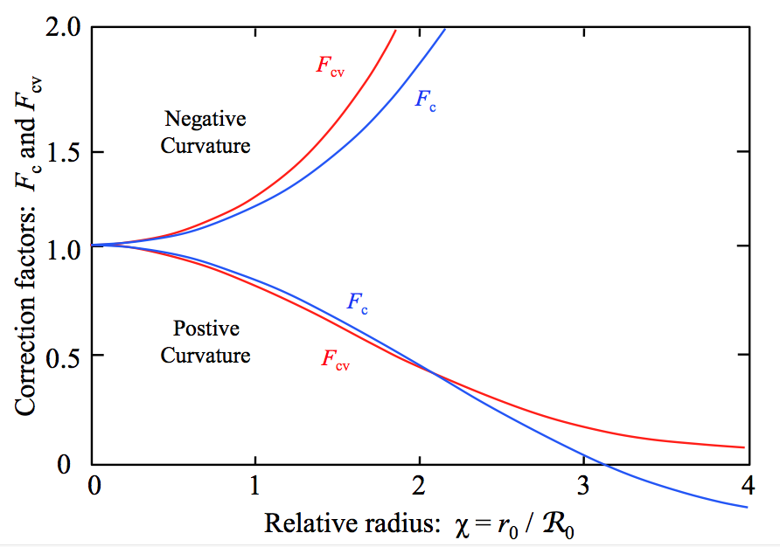





Curvature Radius
The correction factors F_{c} & F_{cv} are shown →
For small χ = r₀ /R₀ we have fractional changes:
Circumference: ±⅙ χ²
Sphere area: ±⅓ χ²
Sphere volume: ±⅕ χ²
Note: at χ = π (antipode), F_{c} = 0 and the circumference goes to zero!
Two things set the value of R₀ :
Cosmic density (ρ)
Cosmic expansion (H)
Start from GR Friedman Eqn:
Several ways to express R
c²/R₀² linked to Newtonian TE.
Here, sign of R² sets sign of curvature
Static region (H = 0) has R ~ ct_{grav} ~ c/√Gρ. E.g. Earth has R ~ 1 lt hr. so χ ~ 10⁻⁴ so δC/C = ⅙ χ² ~ 2×10⁻⁹ so C_{E} is 8 cm smaller than 2πR_{E}.

Slide 25
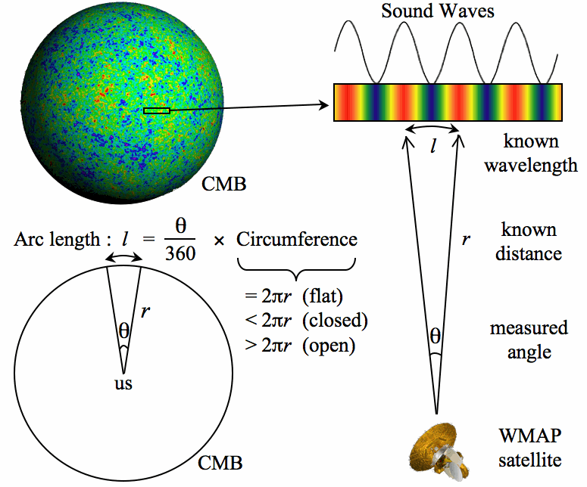
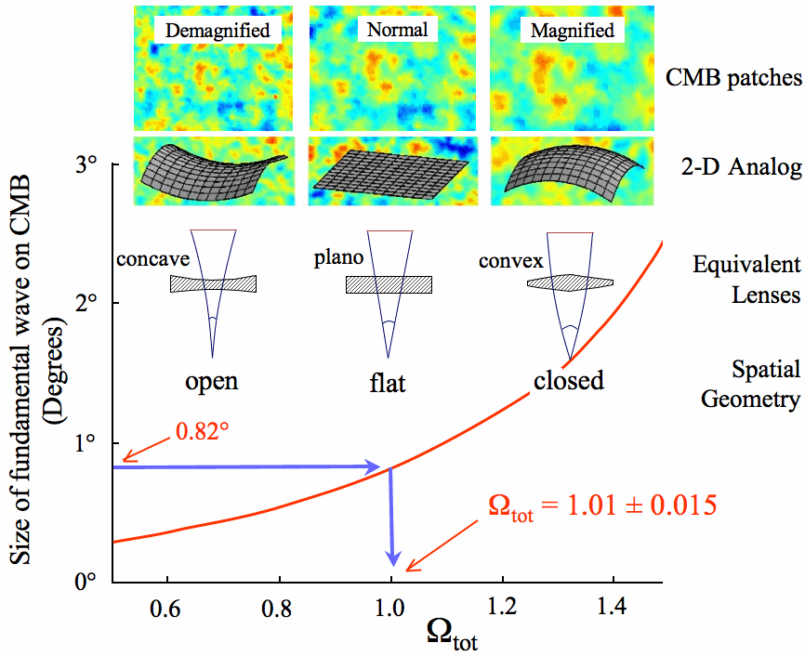
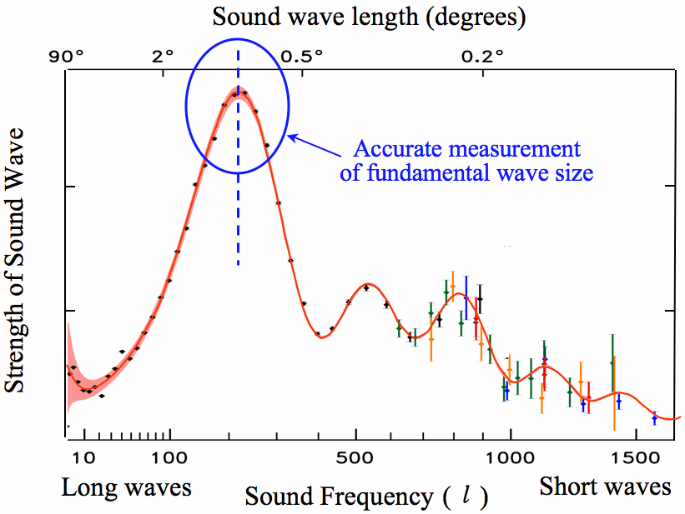
Measuring R for the Universe
Pick biggest circle possible (out to CMB) Measure angle subtended by known length – provided by sound wavelength, l.
Gives F_{c} and hence R₀ (or Ω_{tot,0})
find Ω_{tot,0} = 1.001 ± 0.004 (R₀ ≈ ∞)
So, Euclidean geometry (F_{c} ≈ 1).

Slide 26
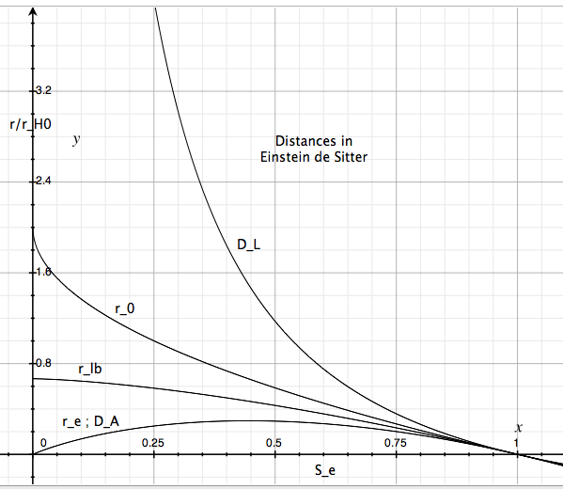
Calculating Luminosity from Flux
What’s the Luminosity, L, of an object at distance r with flux f ?
For a static, Euclidean space: L = 4π r² × f
Where 4π r² = A_{sph} is the area of a sphere of radius r.
A_{sph} = 4πr₀²F_{c}²
When the light reaches us, it’s spread over a sphere radius r₀
In cosmology, we have three complications:
Which r do we use? Answer: we use r₀
Space may not be Euclidean: A_{sph} = 4πr₀² F_{c}²
Redshift reduces photon rate and energy: ×S_{e}⁻²
r₀
Combining these, we have:
L = 4π r₀² F_{c}² S_{e}⁻² × f
D_{L} is large: distant galaxies are very faint.
We may write this as: L = 4π D_{L}² × f
where D_{L} = r₀ F_{c} / S_{e} is the Luminosity Distance: a pseudo-distance that gets L correct using the static Euclidean relation.
Note: need extra power of S_{e} (1/S_{e}) for L_{λ} (L_{ν})

Slide 27
Calculating Surface Brightness
Consider an object of luminosity L and physical area Δ.
Famously, its surface brightness, μ, is independent of distance:
However, in cosmology, expansion adds a new quality:
Recall: D_{A} = r₀ F_{c} S_{e}
and D_{L} = r₀ F_{c} / S_{e}
Thus the surface brightness drops rapidly with redshift (note: S_{e}⁴ = 1/(1+z)⁴ ).
Bad news: makes studying high-z galaxies very hard, however,
Good news: saves us from lethal CMB (10⁶ W/m² → 10⁻⁶ W/m²)
Note: the factor S_{e}⁴ comes explicitly from cosmic expansion (S_{e}² from object being closer when light set out; S_{e} for redshift; S_{e} from reduced rate). Showing galaxies follow μ S_{e}⁴ nicely proves the Universe is expanding (Tolman test).

Slide 28


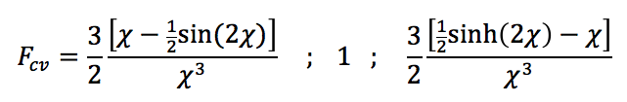


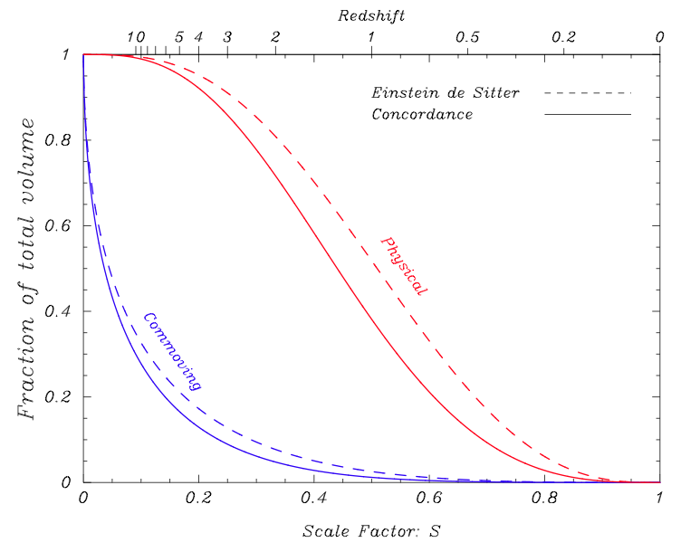
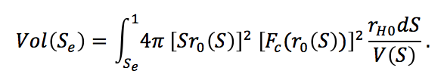
Calculating Volumes
Knowing the volume of a survey is very important – e.g. for calculating the space density of a particular class of objects.
Almost always, we use the comoving volume – the volume out to r₀ in today’s universe. For Euclidean space, this is easy: Vol₀ = ⁴/₃ π r₀³.
For non-Euclidean, each spherical shell has area 4πr₀² F_{c}² so the total volume is:
Recall:
χ = r₀/R₀
See earlier figure
Survey area dΩ from z₁ to z₂:
Visible Universe: = 160 r_{H0}³
Physical (non-comoving) volume out to S_{e}:
Total volume: Vol_{tot} = 1.2 r_{H0}³ (= Vol_{tot,0}/134)
Progress in mapping the entire visible universe:
z(survey): SDSS ~ 0.2; BOSS ~ 1; QSOs ~ 2.5
Mapping the entire visible realm is within reach.

Slide 29
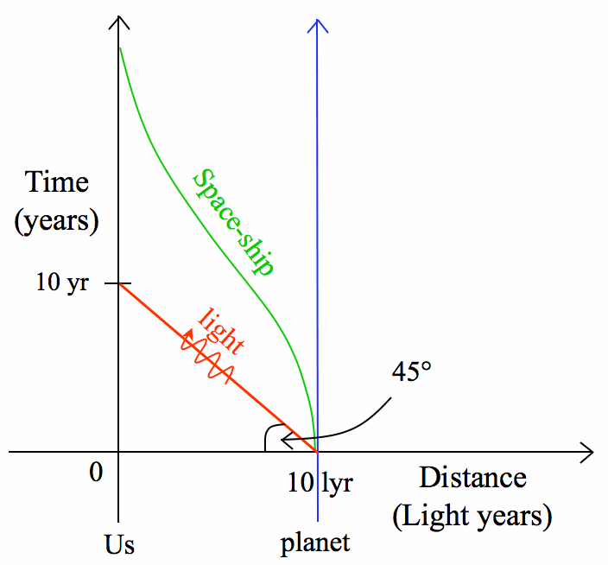
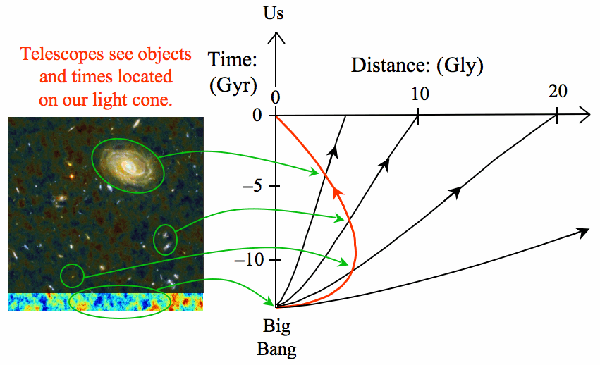
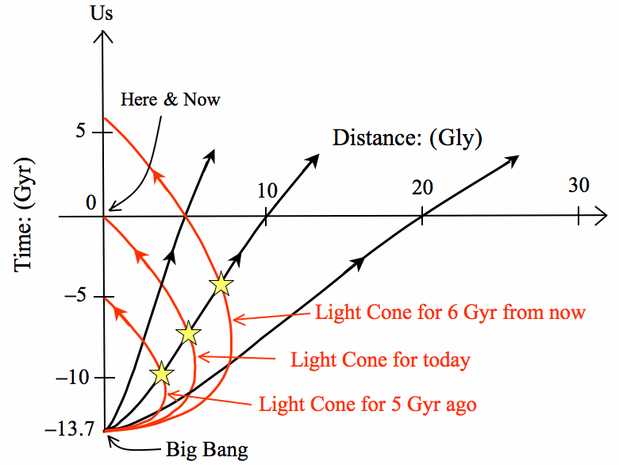
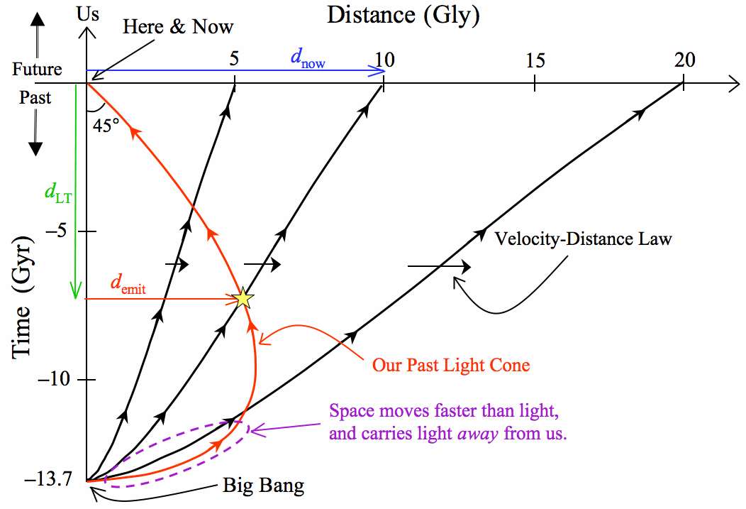
Space-Time Diagrams
These help us think about a number of aspects of our expanding Universe.
Static Space
Expanding Space and today’s past light path (cone)
Observing a single galaxy
Three distances, and the Velocity-Distance Law
r₀
r_{lt}
a) Comoving distance, r₀:
r_{e}

Slide 30
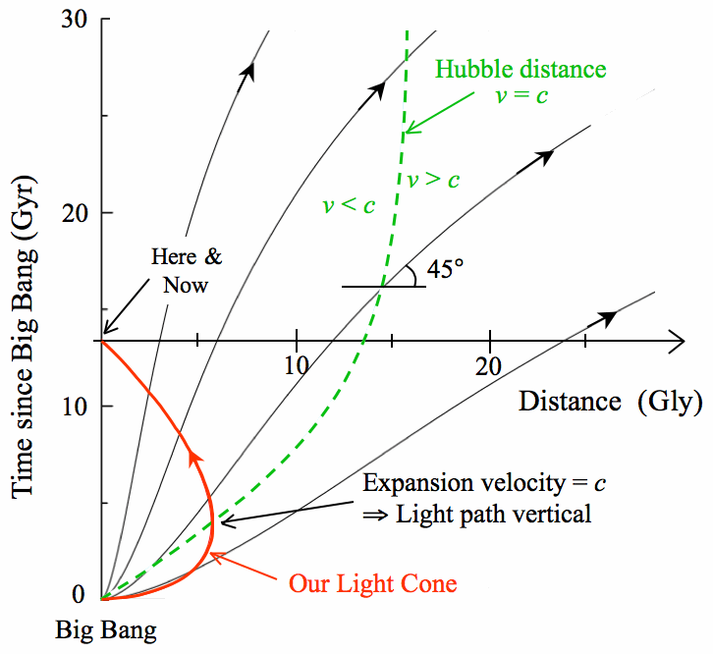
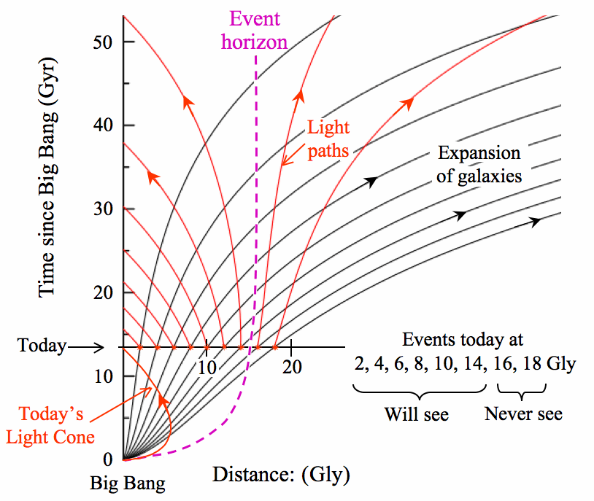
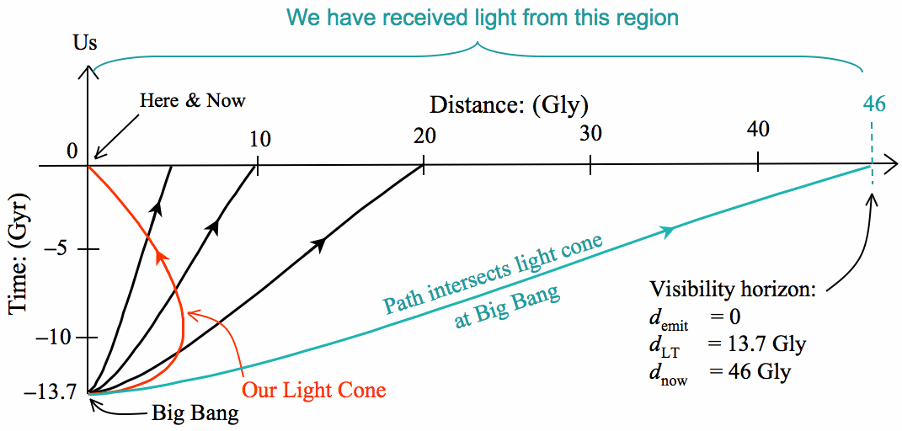


Space-Time Diagrams (cont.)
Various horizons are visible on the space-time diagrams.
Hubble distance:
r_{H} = c/H
= r_{H0} S/V
Event horizon:
Particle horizon (visible limit)

Slide 31
Space-Time Diagrams (cont.)
Full version, showing the light cone, three world lines and three horizons:
Curves plotted as parametric, in S.
E.g. light cone is:
Marked on the light cone are r₀, z, S_{e}

Slide 32
Space-Time Diagram for CMB
The space time diagram for the CMB and its light is an interesting example.
Light leaves at 380,000 yrs moving in our direction.
At that time, the CMB is at r = 40Mly moving at 65c so light recedes from us at 64c.
Recedes for 3.5 Gyr (crosses r_{H}) then approaches and arrives today.
Notice: velocity of CMB material has always been >c and is also outside r_{eh}.

Slide 33
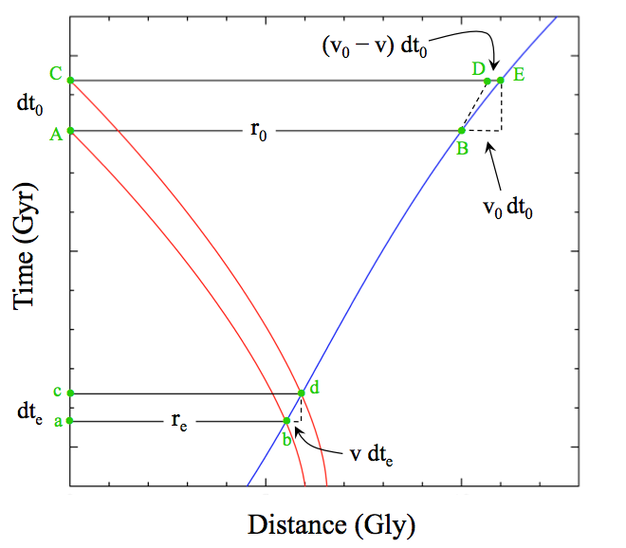
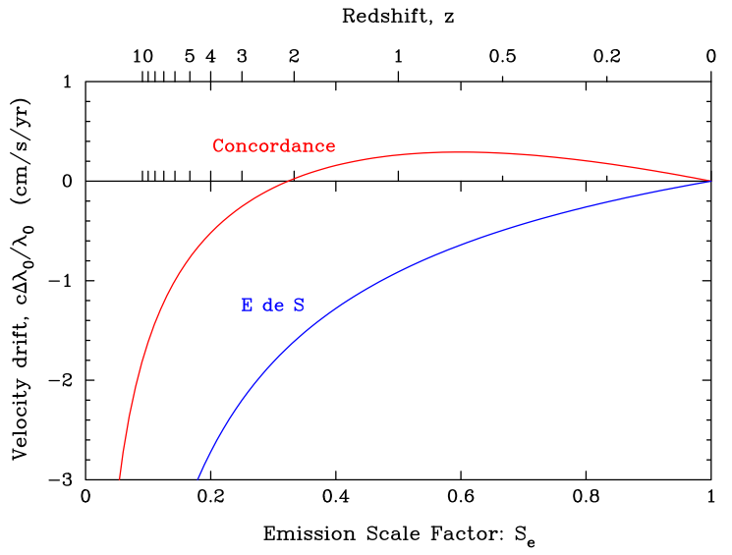
Redshift Drift
An example of real-time cosmology is the steady drift in redshift over cosmic time.
Notice: abcd and ABCD are congruent (sides and depth stretched by 1/S_{e} = 1+z)
But wavelengths stretch the same as distances: so AB/ab = CD/cd = λ₀ / λ_{e}
But true stretch has increased (by DE), so dλ/λ₀ = (v₀ – v)dt₀ / r₀ = (1 – V)dt₀/t_{H0}
Express dλ/λ₀ as dv/c so dv/dt₀ = (1 – V)c/t_{H0} = (1 – V) × 2.2 cm/s/yr (see graph).
Use QSO absorption lines, laser comb spectrographs, and ELT: needs ~10yrs

Slide 34
End of Cosmology Lite

